Slide 1
California Assessment of Student Performance and Progress
(CAASPP)
October 10, 2019

Slide 2
Strategic Plan Alignment
Goal 1: Every student will be prepared for high school and 21st Century citizenship.
Goal 2: Achievement gaps will be eliminated for all student groups in all areas.

Slide 3
CAASPP

Slide 4
What is CAASPP?
CAlifornia Assessment of Student Performance and Progress
The “umbrella” of assessments in public education in California
Smarter Balanced Assessments
ELA and Mathematics in grades 3 - 8 and 11
California Alternate Assessment (CAA) ELA and Math grades 3-8 and 11
California Science Test (CAST) or California Alternate Assessment (CAA) in Science in grades 5, 8, and 10

Slide 5
What is CAASPP?
Smarter Balanced Assessments in English Language Arts and Math include
Computer Adaptive Test
Performance Task
Student Score Reports include
Growth from year to year
Overall performance level and results by claim area
ELA: Reading, Writing, Listening, Research/Inquiry
Math: Concepts & Procedures, Problem Solving & Modeling & Data Analysis, Communicating Reasoning
Information to help parents/guardians and teachers work together to improve student learning
Scores for California Science Tests (CAST) are not yet available and will be provided in late winter

Slide 6
Results

Slide 7
Demographic Data (testing grades only)
District Demographics (Testing grades only)
 | 2014-2015 | 2015-2016 | 2016-2017 | 2017-2018 | 2018-2019
English Learners | 27% (861) | 24% (775) | 20% (659) | 19% (611) | 17% (552)
Reclassified Fluent English Proficient | 23% (725) | 24% (769) | 26% (835) | 26% (831) | 26% (849)
SocioEconomically Disadvantaged | 42% (1339) | 40% (1284) | 38% (1233) | 38% (1231) | 35% (1137)
Students with Disabilities | 12% (368) | 12% (377) | 12% (380) | 11% (365) | 11% (367)
White | 28% (903) | 28% (915) | 30% (955) | 29% (950) | 30% (958)
Asian | 14% (460) | 15% (471) | 12% (394) | 13% (424) | 14% (444)
Hispanic/Latino | 46% (1477) | 44% (1433) | 43% (1376) | 42% (1337) | 40% (1304)
Total Enrollment | 3185 | 3225 | 3223 | 3222 | 3236
*English Language Learners/Reclassified Fluent English Proficient are fluid subgroups

Slide 8
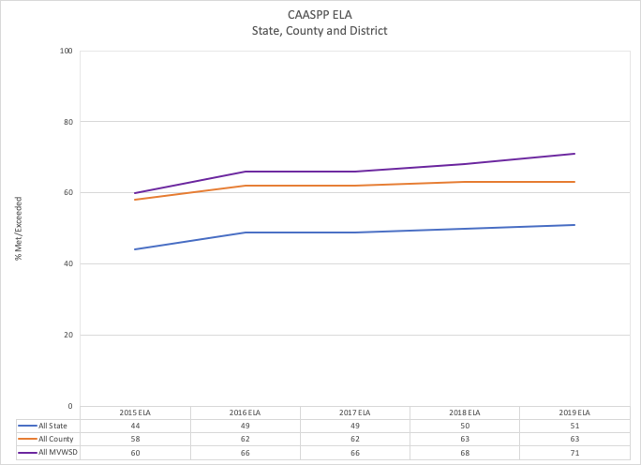

Slide 9
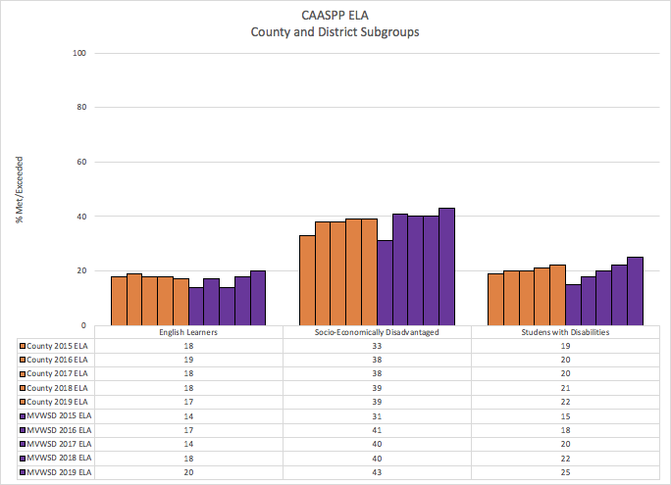

Slide 10
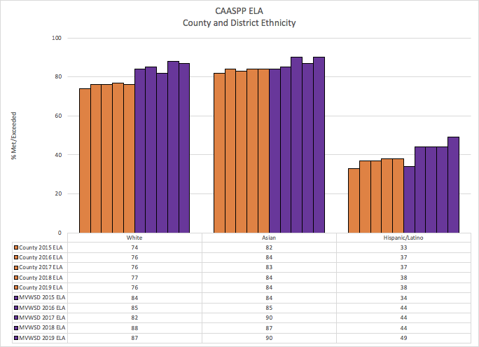

Slide 11
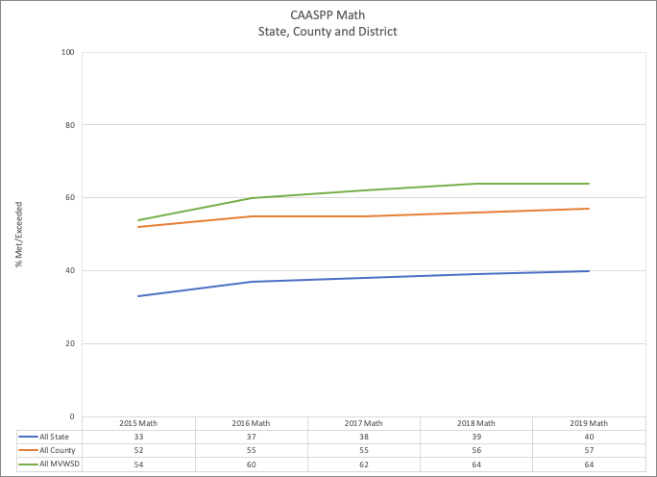

Slide 12
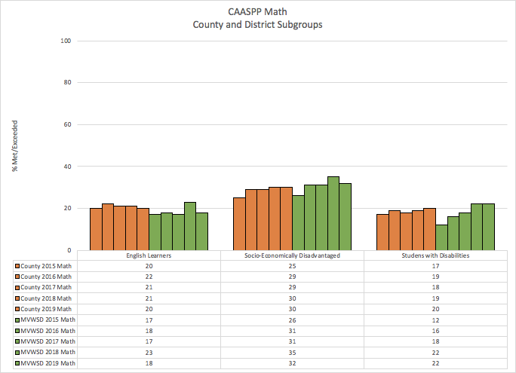

Slide 13
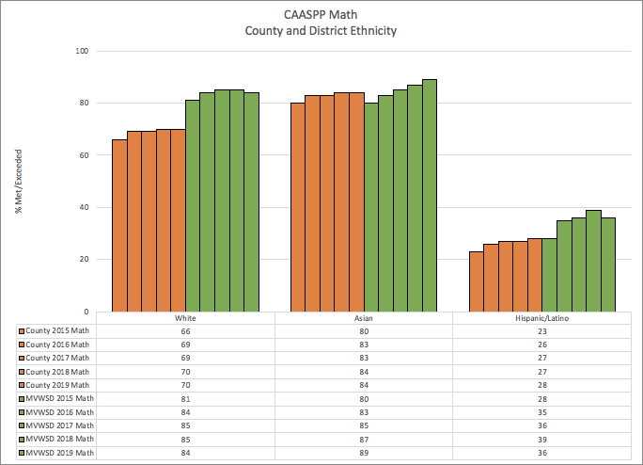

Slide 14
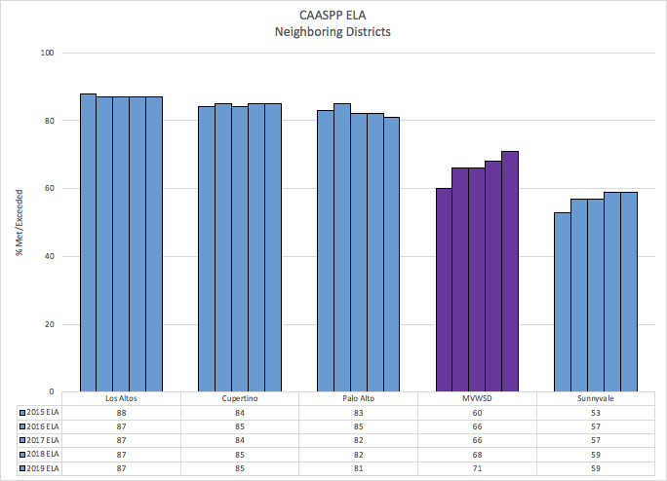

Slide 15
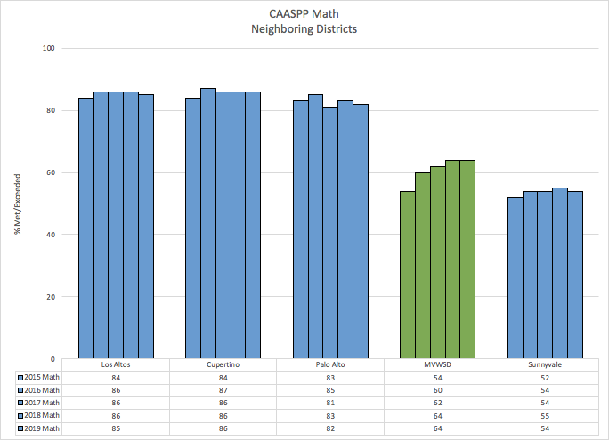

Slide 16
County and Neighboring District Comparison
MVWSD continues to perform at higher rates than the State in ELA and math.
Last year, MVWSD was equal to the County in ELA for English Learners.
This year, MVWSD is 3 percentage points higher
Hispanic/Latino Students, Students with Disabilities, and SocioEconomically Disadvantaged students perform at a higher rate in MVWSD than the County.
English Learners in MVWSD are performing 2 percentage points below the County in math.
While MVWSD is still performing at lower rates than three of our neighboring districts overall in ELA and math, the gap is closing.
In 2015, there was a 28 percentage point gap between MVWSD and Los Altos in ELA. Now there are only 16 percentage points between us.
In 2015, there was a 30 percentage point difference between MVWSD and Los Altos in math. This year, the gap has closed to 21 percentage points.

Slide 17
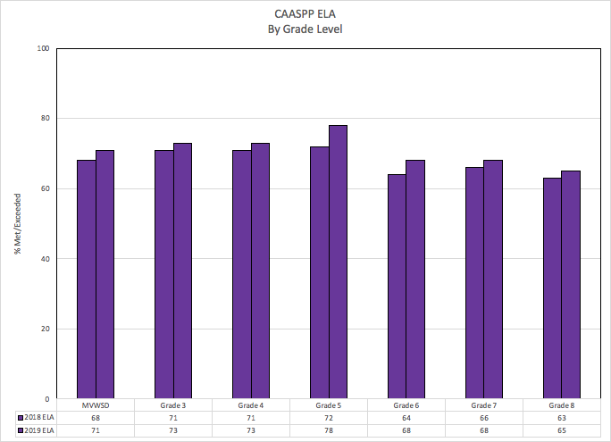

Slide 18
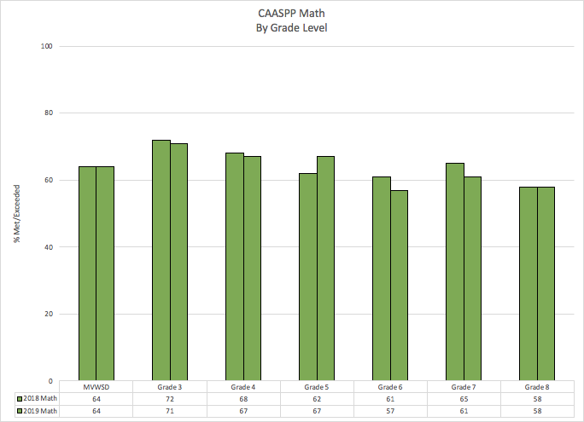

Slide 19
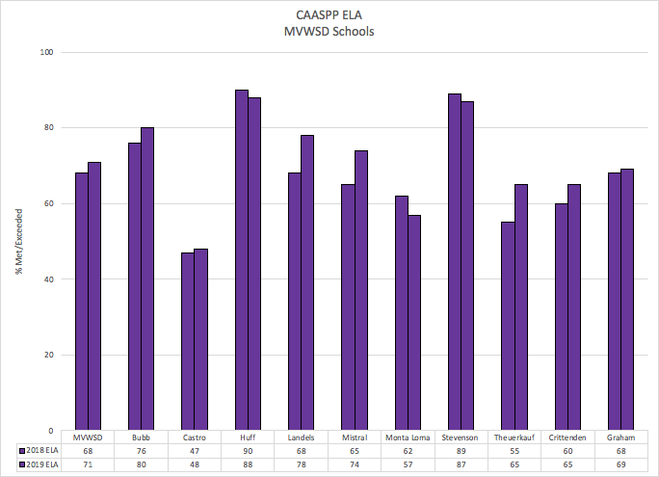

Slide 20
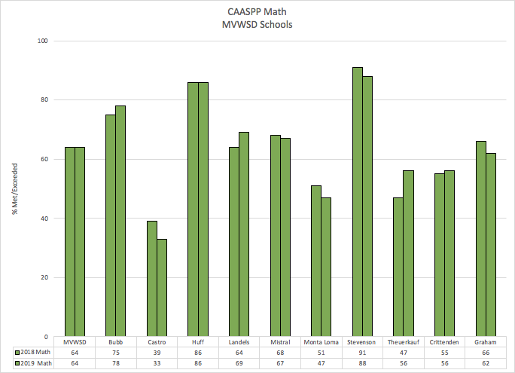

Slide 21
Grade Level Outcomes
ELA
Overall, MVWSD saw a 3 percentage point gain in ELA over 2017-18
Gain of 11 points since 2014-15
All grade levels improved in ELA over last year with grade 5 having the greatest improvement (+6)
Math
Overall, MVWSD was flat in math from 2017-18 to 2018-19
Gain of 10 percentage points since 2014-15
Grade 5 demonstrated the highest increase (+5)
Grades 6 and 7 decreased by 4 percentage points

Slide 22
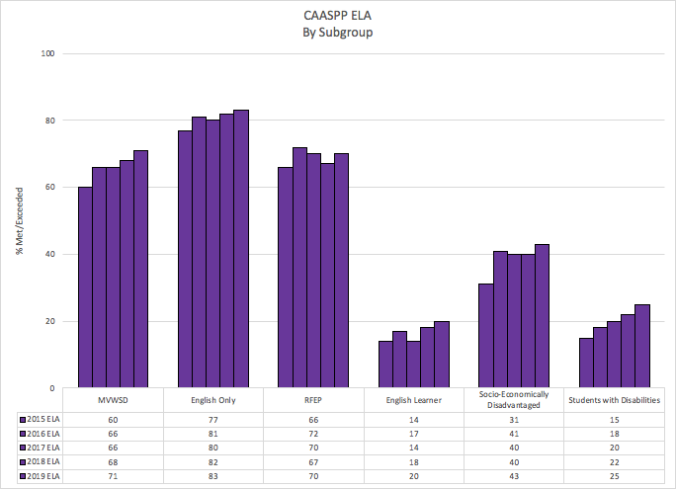

Slide 23
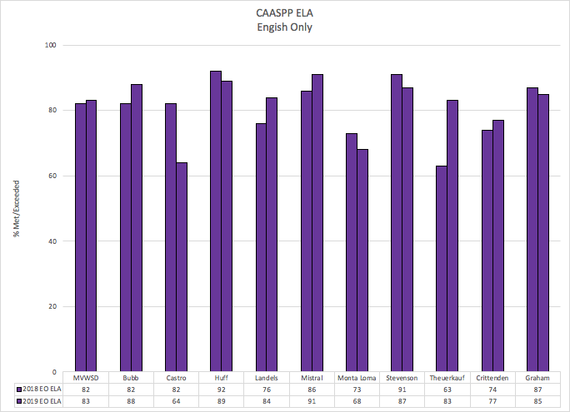

Slide 24
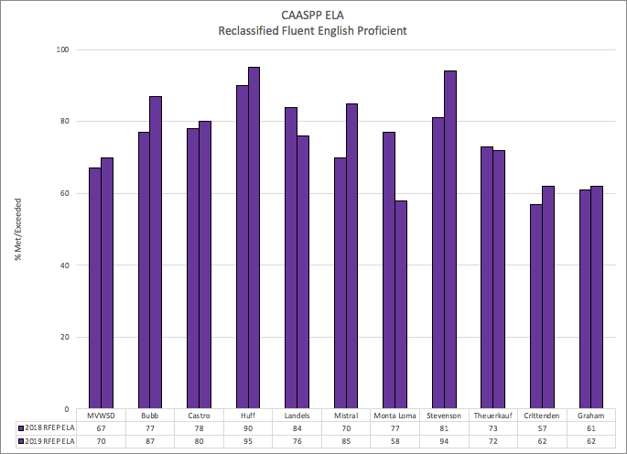

Slide 25
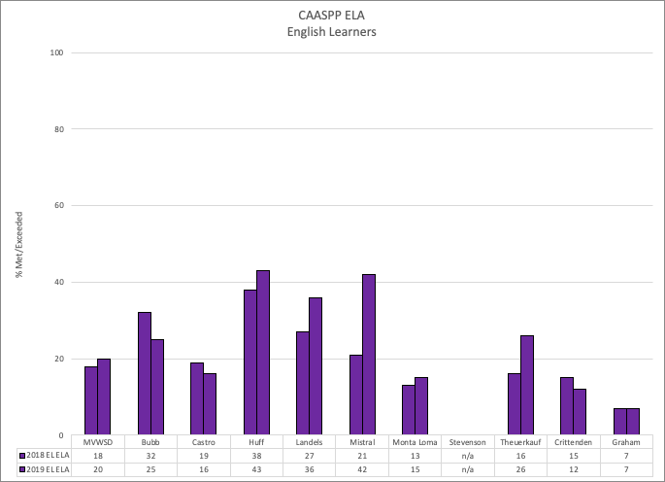

Slide 26
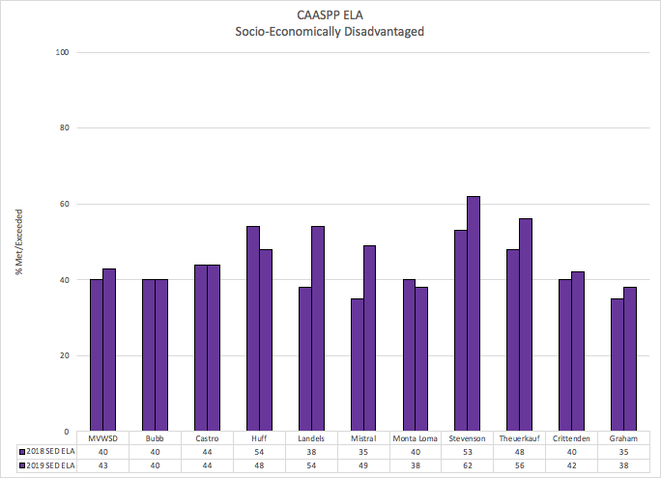

Slide 27
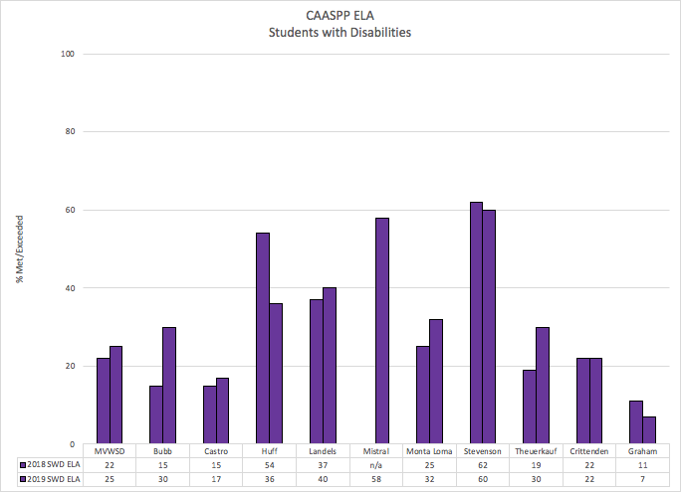

Slide 28
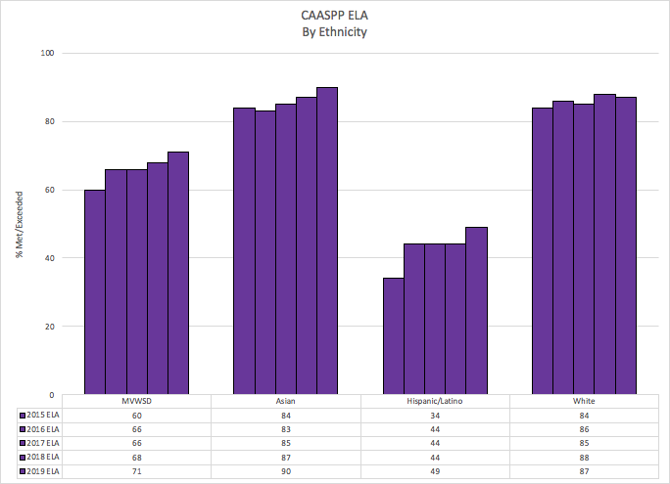

Slide 29
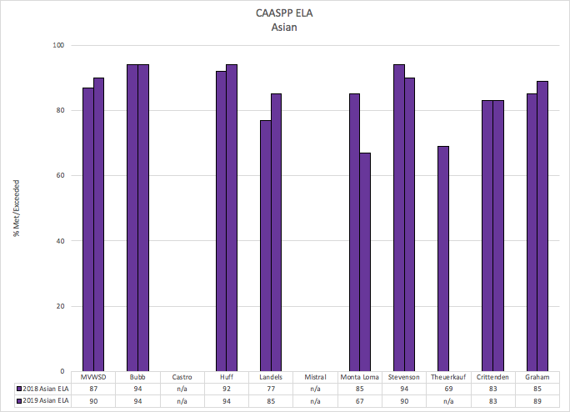

Slide 30
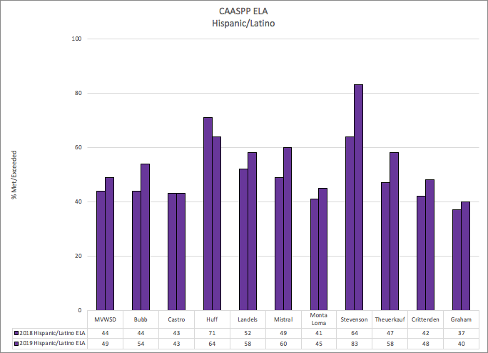

Slide 31
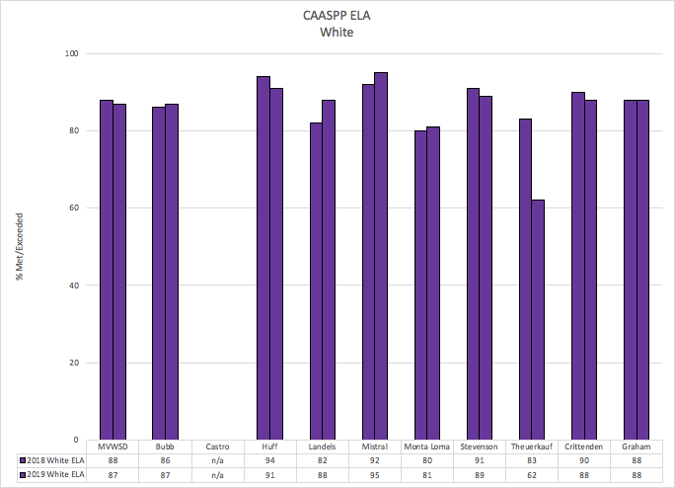

Slide 32
English Language Arts Outcomes
All subgroups with the exception of our White group demonstrated gains in ELA over 2017-18
RFEP (+3)
EL (+2)
SED (+3)
SWD (+3)
Asian (+3)
Hispanic/Latino (+5)
White (-1)
Intentional focus on core ELA instruction and pacing in Middle School
Intentional focus on RFEP students in 2018-19
Sites wrote specific goals for RFEP student monitoring
RTI provided data driven, targeted focus in ELA for all students
SIOP strategies were targeted in ELA

Slide 33
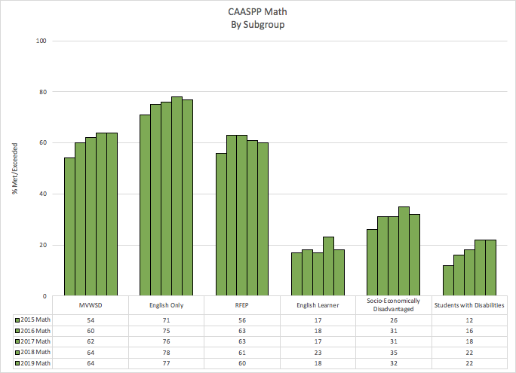

Slide 34
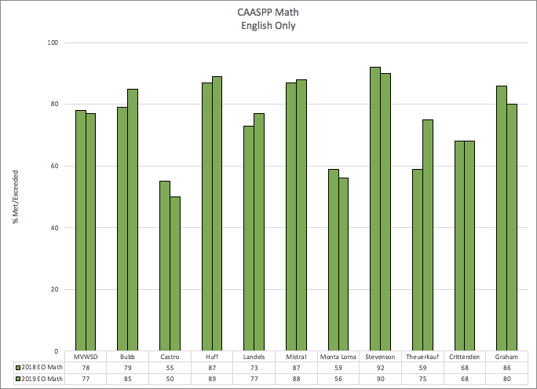

Slide 35
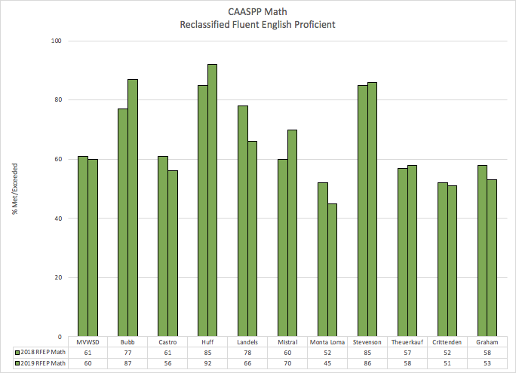

Slide 36
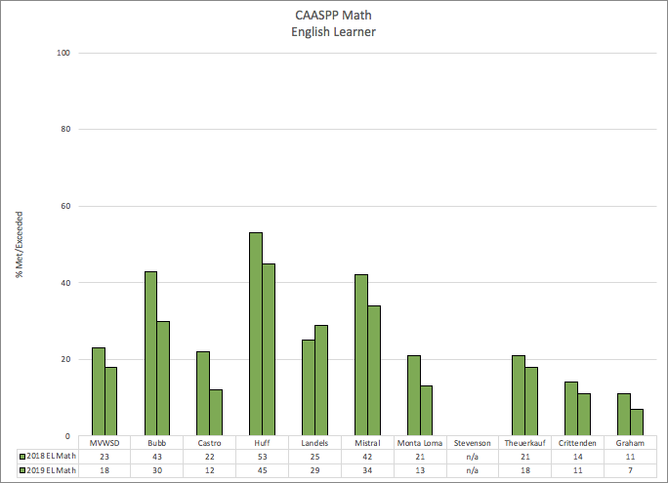

Slide 37
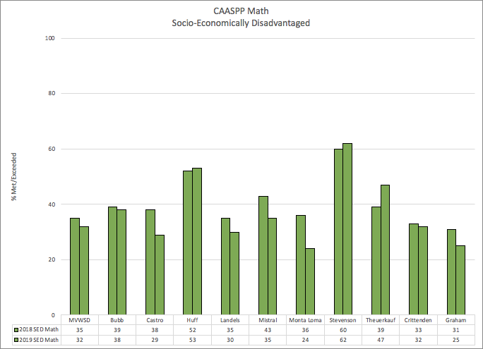

Slide 38
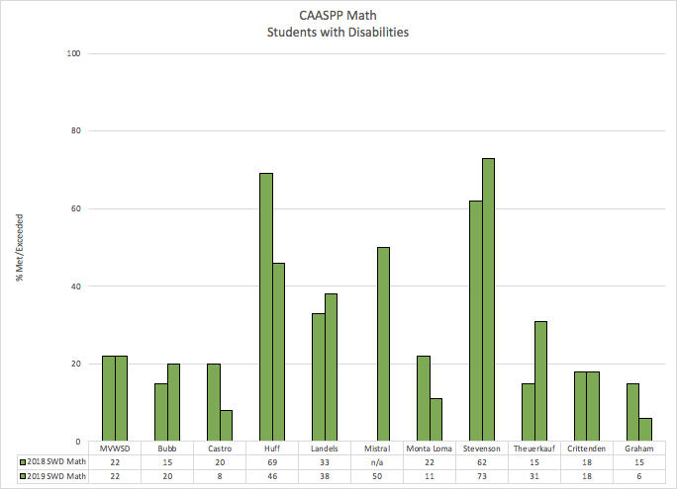

Slide 39
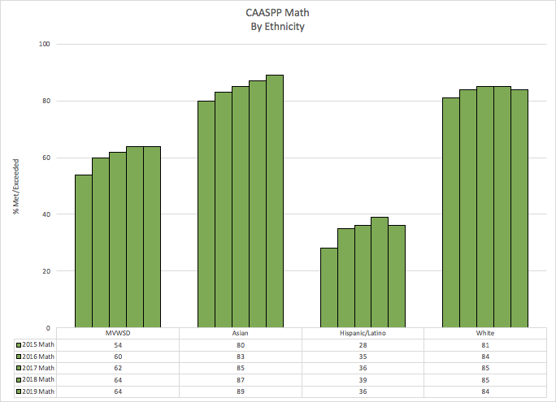

Slide 40
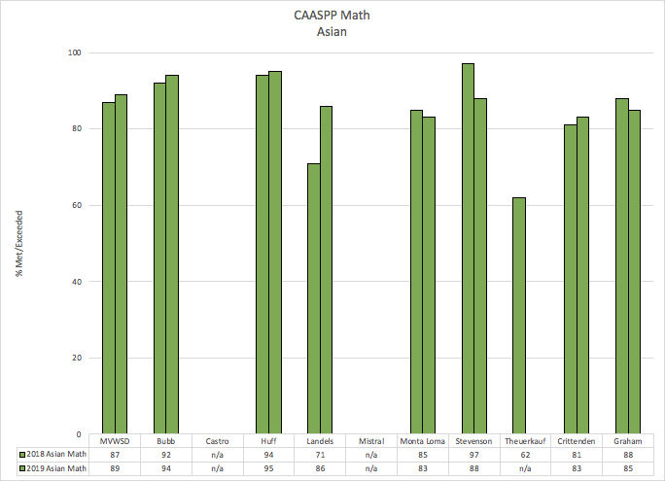

Slide 41
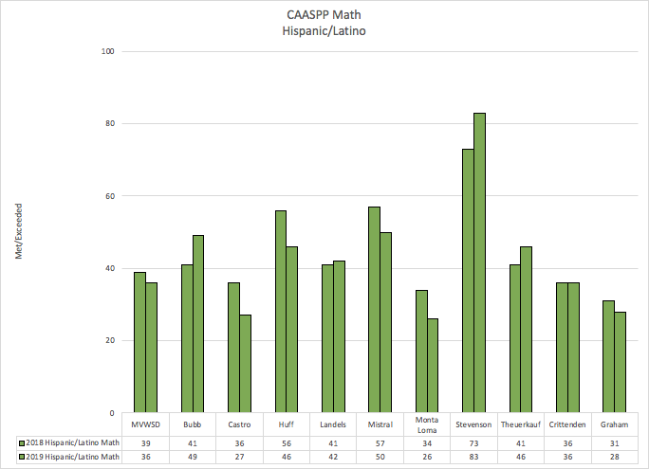

Slide 42
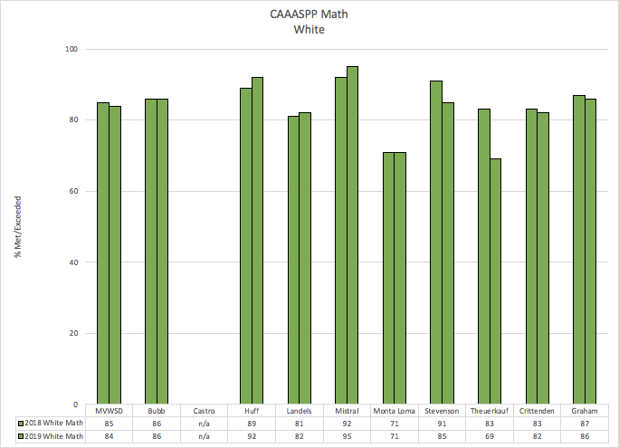

Slide 43
Math Outcomes
Subgroups were fairly flat in math over 2017-18 with English Learners and Economically Disadvantaged students having the greatest deficits
RFEP (-1)
EL (-5)
SED (-3)
SWD (flat)
Asian (+2)
Hispanic/Latino (-2)
White (-1)
Elementary math coach focused on grade 5 (the only grade level to see significant gains)
First year transitioning from 2 periods of math to 1 (6.1, 7.0, 7.1, 8.0)
SIOP strategies were inconsistently used in math
Goals for ELs, RFEPs, and RTI at elementary were focused on ELA rather than math

Slide 44
Trends

Slide 45
Site Trends - Gains in ELA
Landels | Overall 10 percentage point gain in ELA. Most significant gains with SocioEconomically Disadvantaged students (+16) and English Learners (+9). Decrease in performance for RFEP students (-8)
Theuerkauf | Overall 10 percentage point gain in ELA. Most significant gains for English Learners (+10), Hispanic/Latino (+11), Students with Disabilities (+11). Slight decrease in performance for RFEP students (-1)
Mistral | Overall 9 percentage point gain in ELA. Significant gains for English Learners (+21), Hispanic/Latino (+11), SocioEconomically Disadvantaged students (+14), and RFEP students (+15)
Crittenden | Overall, 5 percentage point gain in ELA. Most significant gains with RFEP (+5) and Hispanic/Latino students (+6). Struggled with English Learners (-3)
Bubb | Overall, 4 percentage point gain in ELA. Most significant gains with RFEP (+10), Hispanic/Latino (+10), and Students with Disabilities (+15) Struggled with English Learners (-7)
Castro | Overall, 1 percentage point gain in ELA. Increase of 2 percentage points for RFEP students and Students with Disabilities. Struggled with English Learners (-3)
Graham | Overall, 1 percentage point gain in ELA. Increase of 3 percentage points for Hispanic/Latino and SocioEconomically Disadvantaged students Struggled with Students with Disabilities(-4)

Slide 46
Site Trends - Declines in ELA
Monta Loma | Overall, 5 percentage point decrease in ELA. Gains for English Learners (+2), Hispanic/Latino (+4), and Students with Disabilities (+7) Decrease in performance for RFEP(-19)
Huff | Overall, 2 percentage point decrease in ELA. Gains for English Learners (+5) and RFEPs (+5) Struggled with Hispanic/Latino (-7), SocioEconomically Disadvantaged students (-6), and Students with Disabilities (-19)
Stevenson | Overall, 2 percentage point decrease in ELA. Significant gains for RFEPs (+13), Hispanic/Latino (+19), SocioEconomically Disadvantaged students (+9), English Learners were flat.

Slide 47
Site Trends - Gains in Math
Theuerkauf | Overall, 9 percentage point gain in math. Most significant gains with SWD (+16), SED (+8) , and HL (+5) Struggled with EL (-3)
Landels | Overall, 5 percentage point gain in math. Most significant gains with EL (+4) and SWD (+5) Struggled with RFEP (-12) and SED ( -5)
Bubb | Overall, 3 percentage point gain in math. Most significant gains with RFEP (+10) and HL (+8) Struggled with EL (-13)
Crittenden | Overall, 1 percentage point gain in math. Most significant gains with Scores were relatively flat in all groups
Huff | Overall, no gain or loss in math. Most significant gains with RFEP (+10) Declines for EL (-8) and SWD (-23)

Slide 48
SIte Trends - Declines in math
Castro | Overall, 6 percentage point decrease in math with similar declines across all subgroups
Monta Loma | Overall, 4 percentage point decrease in math Minor declines for English only students More significant declines for EL, RFEP, SED, SWD
Graham | Overall, 4 percentage point decrease in math with similar declines across most subgroups. SWD demonstrated the most significant decline
Stevenson | Overall, 2 percentage point decrease in math While there were increases in subgroups (EL, RFEP, SED, H/L) these subgroups are small and students in larger subgroups did not improve
Mistral | Overall, 1 percentage point decrease in math Increase of 10 percentage points for RFEP Decrease of 8 percentage points for EL, HL, and SED

Slide 49
CAASPP Results based on new boundaries

Slide 50
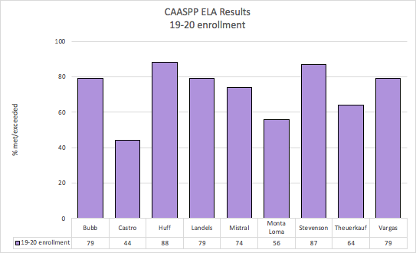

Slide 51
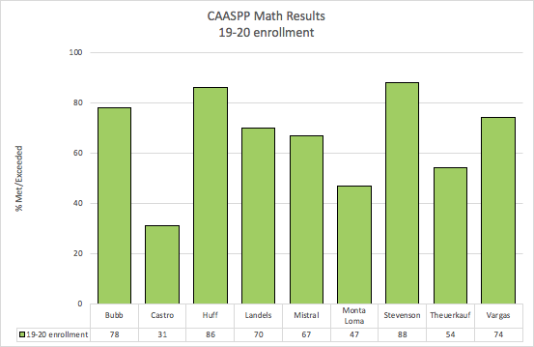

Slide 52
Changes Based on New Boundaries
Reviewing 2018-19 results with 2018-19 enrollment allows us to
Mirror the data that will be shared from the State
Understand the impact of the actions and practices in place
Reviewing 2018-19 results with 2019-20 enrollment allows us to
Develop goals and actions for current students
Include Vargas in results
In reviewing data with new enrollment:
Some sites had no change
Some sites had an increase or decrease of 1 or 2 percentage points
Castro has the most significant change with a 4 percentage point decrease in ELA and 2 percentage point decrease in math

Slide 53
Next Steps

Slide 54
Next Steps
Data analysis and site plans
Continued focus on data analysis to make decisions
Added new goals and actions for site plans
Address the needs of high performers and increase rigor in the classroom
Increase communication with parents and students about academic performance
Monitor progress of English Learners who score level 4 on ELPAC supporting them to reclassify or maintain proficiency in English
English Learner Board Goal group monitoring
Curriculum and pacing guides
Newly developed ELA pacing at MS
Revised math pacing at MS with support of Math Coordinator
Elementary ELA includes new material
Elementary math includes parent support documents
New Science/ELA scope and sequence
Notes:
Site Plans to include a goal for RFEP
Curriculum - PD on curriculum planning
Elem Pacing guides updated to include additional features including heavily assessed standards and objectives
New MS ELA pacing guide collaboratively created by ELA dept to ensure that we are addressing the standards/claims necessary for student success
Assessments adjusted based on feedback - aligned to SBAC blueprints
Added Elem Math coach to support the downward trend in math
RTI at MS this year to fill gaps and support

Slide 55
Next Steps
Assessments
Change to i-Ready
Continue with Literably and writing
Coaching
More intentional focus of professional development and coaching structure
SIOP
Math
Differentiation
Response to Intervention
Change in Elementary format
Science integration into Literacy
More intentionally targeted and differentiated
Middle school - additional training and support
Notes:
Site Plans to include a goal for RFEP
Curriculum - PD on curriculum planning
Elem Pacing guides updated to include additional features including heavily assessed standards and objectives
New MS ELA pacing guide collaboratively created by ELA dept to ensure that we are addressing the standards/claims necessary for student success
Assessments adjusted based on feedback - aligned to SBAC blueprints
Added Elem Math coach to support the downward trend in math
RTI at MS this year to fill gaps and support

Slide 56
Next Steps
Professional Learning Communities
Administrators
Teachers
Coaches
Professional Development
Sheltered Instruction Observation Protocol - Year 3
Back to School Training
SIOP and i-Ready training for all teachers
Specific training for Middle School Subject areas
Elementary NGSS and Differentiation
Middle School Math training
Math training and support at Castro and Monta Loma
Build off of the work with elementary math coach to replicate work done with grade 5
Optional Professional Development
Professional Development for administrators

Slide 57
Questions?

